Slide 1
Box Mover Project
Graham Kroll
Engr-3414
Fall 2024

Slide 2


AGENDA
Problem statement
Constraints
Design Space
Materials List
Assembly
Discussion
Conclusion

Slide 3

Problem Statement
The members of ENGR 3414 were tasked with designing a machine to reduce employee injuries in their product-sorting business using the Engineering Design Process. This device will sort packages by weight, placing heavier items at the bottom and lighter ones at the top, using color codes for weight identification. The team plans to build a prototype for a feasibility study to evaluate the machine's effectiveness.

Slide 4
Constraints
Time
Budget
Resources

Slide 5
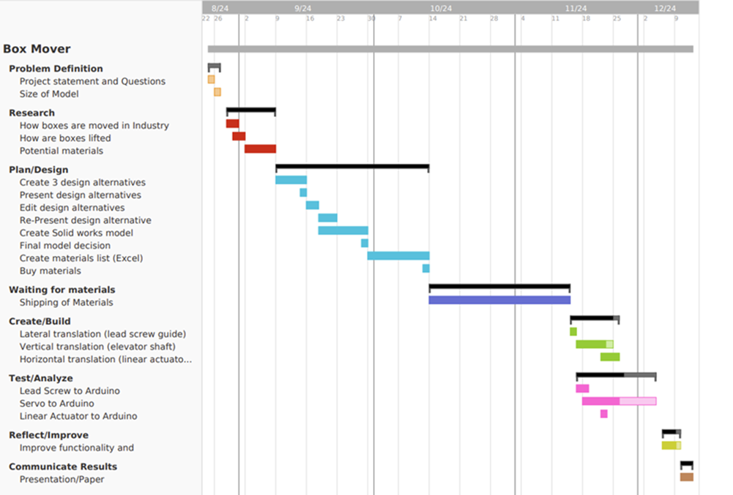
Gantt Chart

Slide 6
Design Space

Slide 7
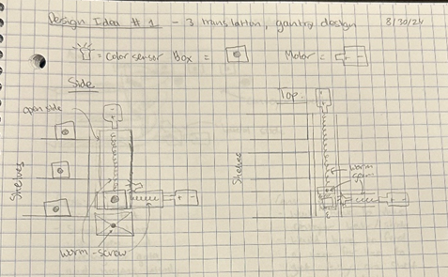
Design 1 – Gantry
EACH DEGREE OF MOTION HAS A WORM GEAR
MODULAR
PRECISE
EASY TO SCALE
EXTRA MATERIALS
BOTTOM SHELF RECTIFICATION

Slide 8
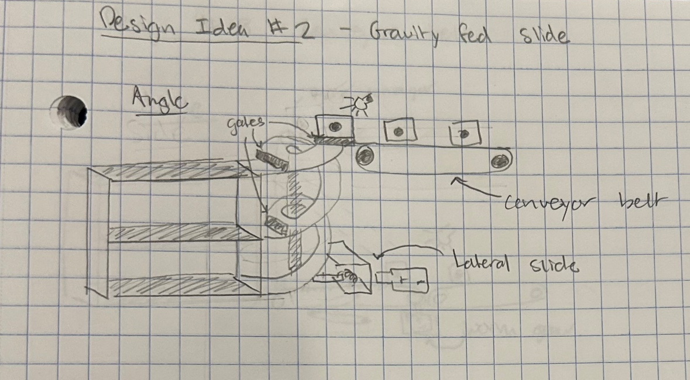
Design 2 – Slide
ELEVATED CONVEYOR BELT
SERIES OF GATES
CODING SIMPLE
DIFFICULT LATERAL TRANSLATION
SPEED CONTROL
SLIDE MATERIAL

Slide 9
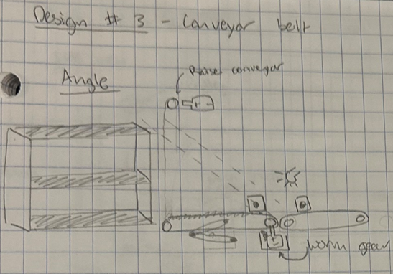
Design 3 – Conveyor Belt
SERIES OF CONVEYORS
PULLEY SYSTEM FOR ELEVATION
CONTROLLED FEEDS
DIFFICULT LATERAL TRANSLATION
PIVOT OR WORM GEAR
MULTIPLE MOTORS

Slide 10
Decision Matrix
Criteria | Weight (%) | Gantry | Gravity-Fed Slide | Conveyor Belt
Cost | 20% | 5 | 6 | 5
Complexity | 10% | 7 | 8 | 5
Speed | 15% | 6 | 8 | 7
Scalability | 15% | 5 | 3 | 7
Safety | 20% | 9 | 6 | 7
Energy Efficiency | 5% | 4 | 9 | 6
Durability | 15% | 8 | 7 | 5
Total | 100% | 6.55 | 6.35 | 6.05

Slide 11
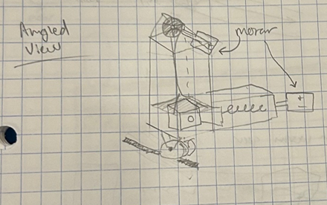
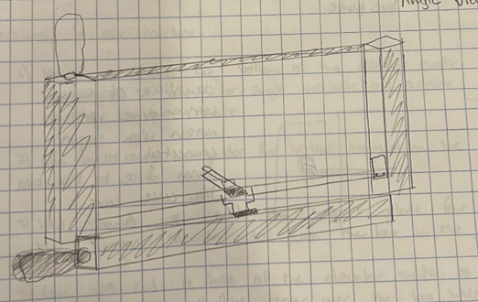
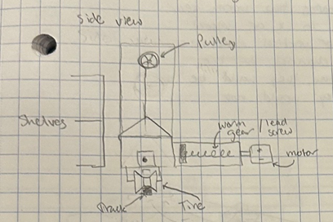
Refactored design

Slide 12
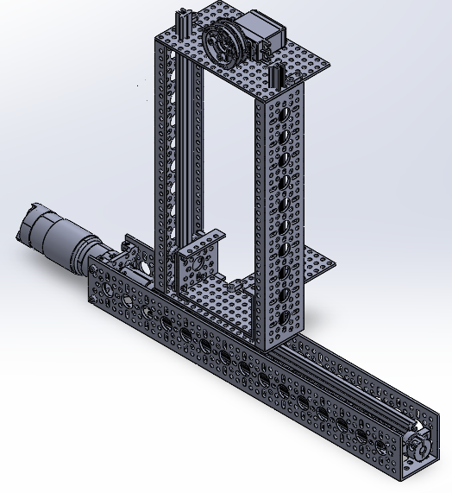
Model

Slide 13
Materials

Slide 14
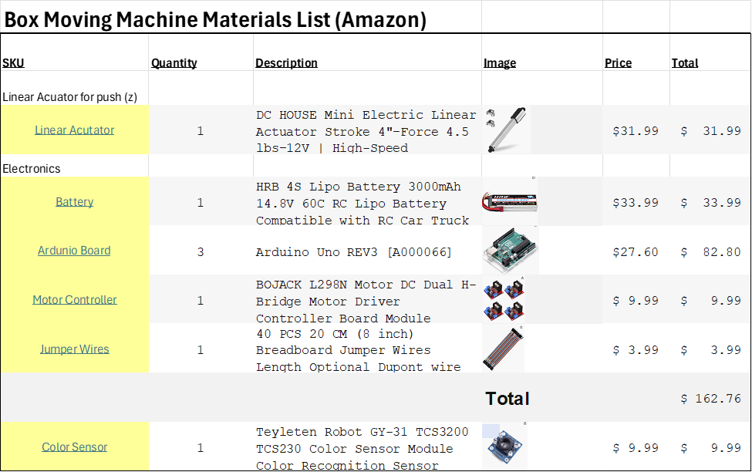
List

Slide 15
Assembly

Slide 16
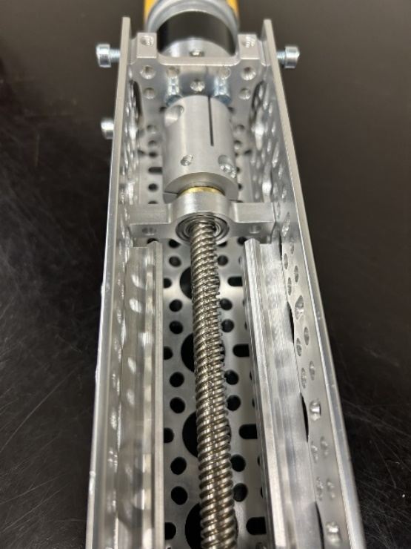
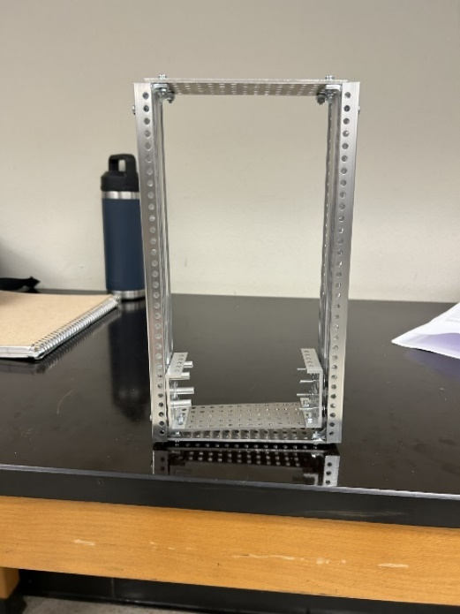
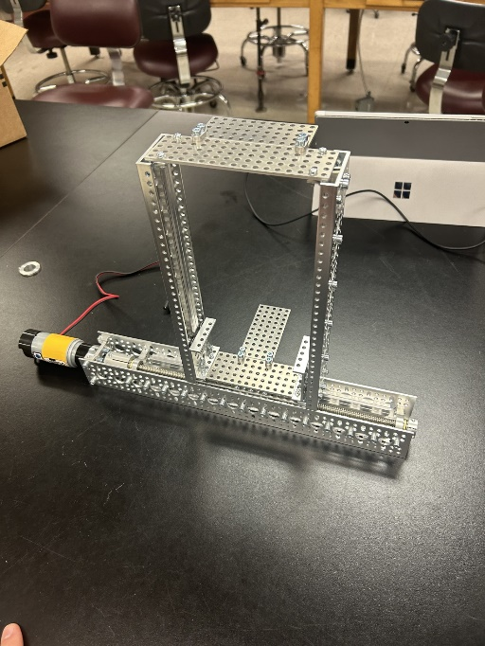
Day 1-2
STRUCTURE
Horizontal assembly
Hyper couple, pillow block
M4 BOLTS
Troubleshooting elevator
Horizontal rocking

Slide 17
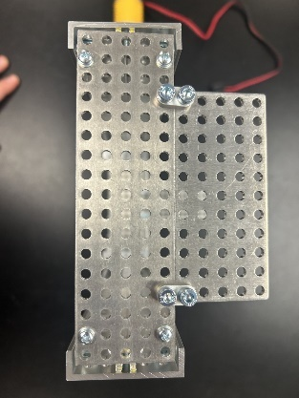
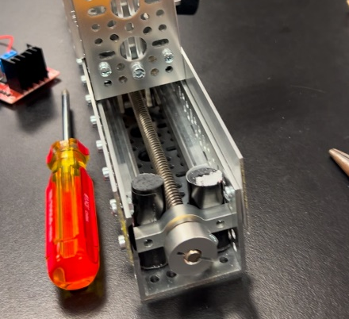
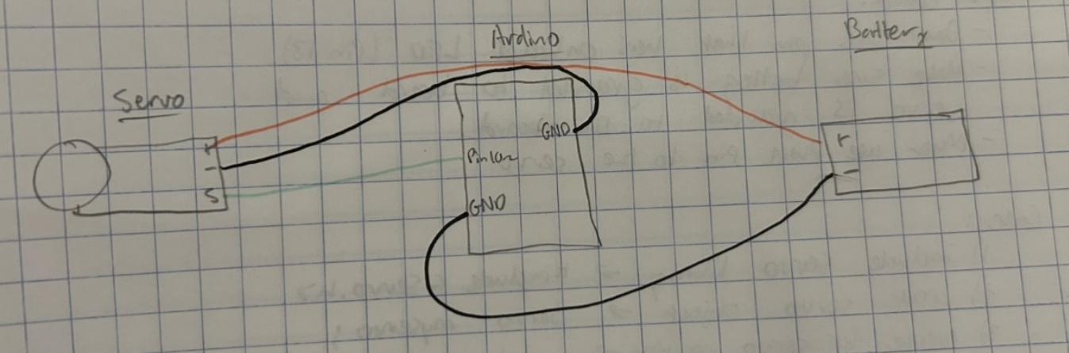
Day 3-4
FRICTION/SERVO
Guide rails
Padding
Tension on bearings
PROPER GROUNDING

Slide 18
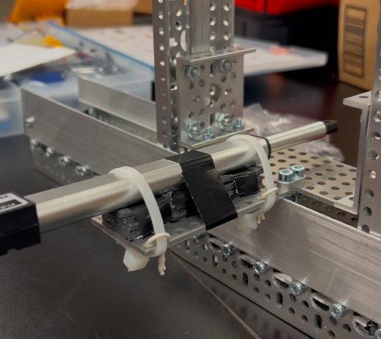
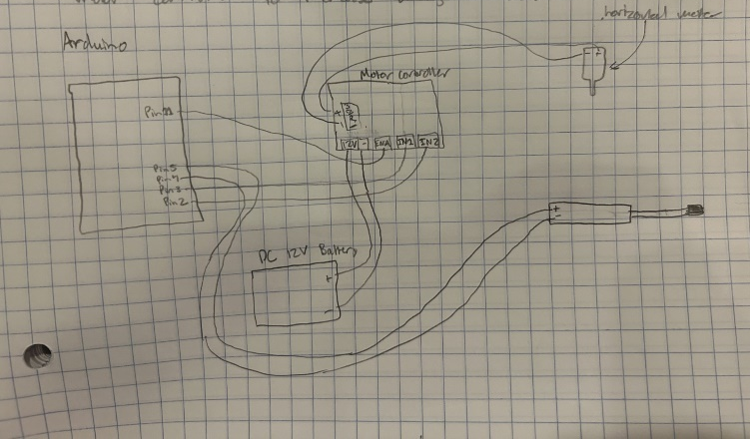
Day 5-6
INTEGRATION
Servo resolution
Mounting linear actuator
Two degrees of translation

Slide 19


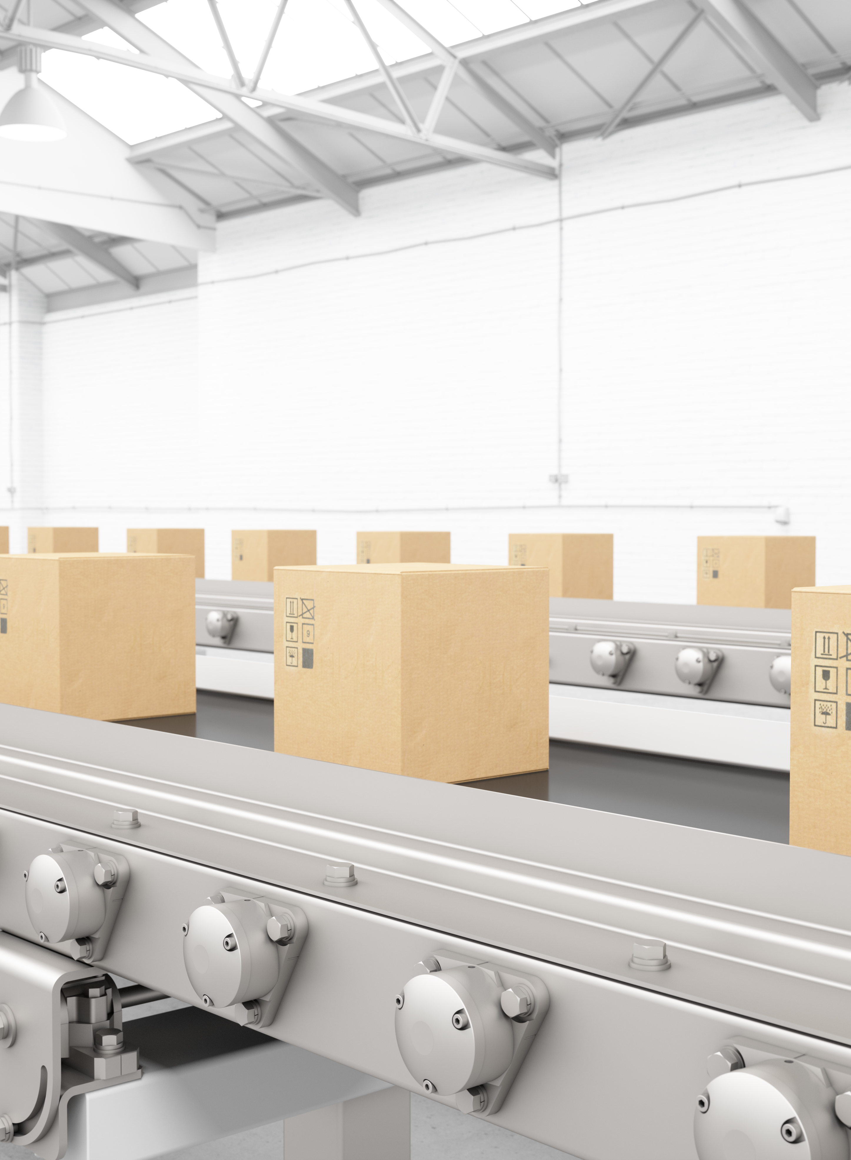
Discussion
Why is it important?
25% of work force missing 10 days due to back pain (“Chronic Back Pain”).
40% of adults had back pain in 2019 (Lucas, Jacqueline W., et al)
Who will it affect?
Our product can aid all workers in the warehouse industry
More days at work and longer working careers

Slide 20

Conclusion
ENGINEERING DESIGN PROCESS
USE OF AI
SYNTAX NATIGATION
PROBLEM SOLVING
NEXT STEPS

Slide 21
THANK YOU
GRAHAM KROLL
gkroll4600@dbu.edu

Slide 22
References
Arduino Forum. "Hook up Servo to a L298N." Arduino Forum, 30 Sept. 2015, https://forum.arduino.cc/t/hook-up-servo-to-a-l298n/336030.
Arduino Documentation. "Servo Library." Arduino Docs, https://docs.arduino.cc/libraries/servo/.
“Chronic Back Pain.” Health Policy Institute, 13 Feb. 2019, hpi.georgetown.edu/backpain/.
Circuito.io. "Arduino Uno Pinout." Circuito.io Blog, https://www.circuito.io/blog/arduino-uno-pinout/#:~:text=Pins%200%2D13%20of%20the,10%2C11%20have%20PWM%20capability..
Dhanushka. Controlling a Servo Motor with Arduino and L298N Motor Driver. YouTube, 6 Aug. 2019, https://www.youtube.com/watch?v=kUHmYKWwuWs&t=1074s.
DroneBot Workshop. Using L298N Motor Driver with Arduino - DC Motor Control. YouTube, 16 Sept. 2020, https://www.youtube.com/watch?v=NV6YHZ2RAqc.
Lucas, Jacqueline W., et al. “NCHS Data Brief ■ No. 415 ■ July 2021.” National Center for Health Statistics, July 2021, www.cdc.gov/nchs/data/databriefs/db415-h.pdf.
HowToMechatronics. "Arduino DC Motor Control Tutorial – L298N PWM H-Bridge." HowToMechatronics, https://howtomechatronics.com/tutorials/arduino/arduino-dc-motor-control-tutorial-l298n-pwm-h-bridge/.

